Slide 1


COM 429: MULTIMEDIA TECHNOLOGIES
Operating systems in Multimedia systems

Slide 2
Multimedia OS
Introduction to multimedia
Multimedia files
Video compression
Multimedia process scheduling
Multimedia file system paradigms
File placement
Caching
Disk scheduling for multimedia

Slide 3
Introduction to Multimedia -Terms
Multimedia : more than one medium
Video : pictures
Audio : sound
DVD (Digital Versatile Disk) – 5 to 17 GB
Cable TV
ADSL (Asymmetric Digital Subscriber Loop)
Video on Demand (select a movie of your choice)

Slide 4
What is ADSL?
Asymmetric Digital Subscriber Loop
2-8 Mbps downstream
640 - 960 kbps upstream
Enables high speed data on a single pair of local copper loop
Runs voice and data concurrently over same pair of wire

Slide 5



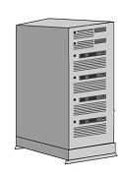
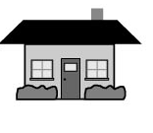


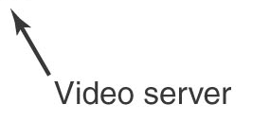

Video On Demand : Satellite Transmission
Satellite
Satellite Dish

Slide 6
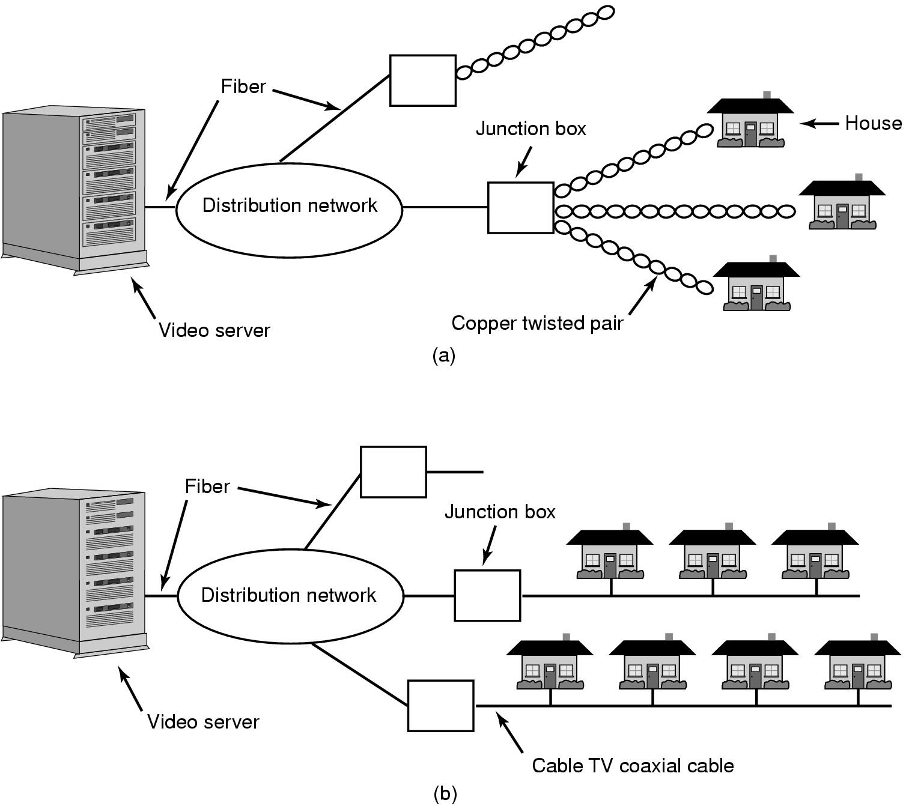
Video On Demand: ADSL - Cable
ADSL
Cable

Slide 7
Video On Demand Infrastructures
Video Server : a powerful computer that stores many movies in its file system and plays them on demand
A distribution network: satellite, ADSL or cable
Set-top box in each house for decoding and decompressing the signal (PC in a box containing a CPU, RAM, ROM and an interface to the distribution network)

Slide 8
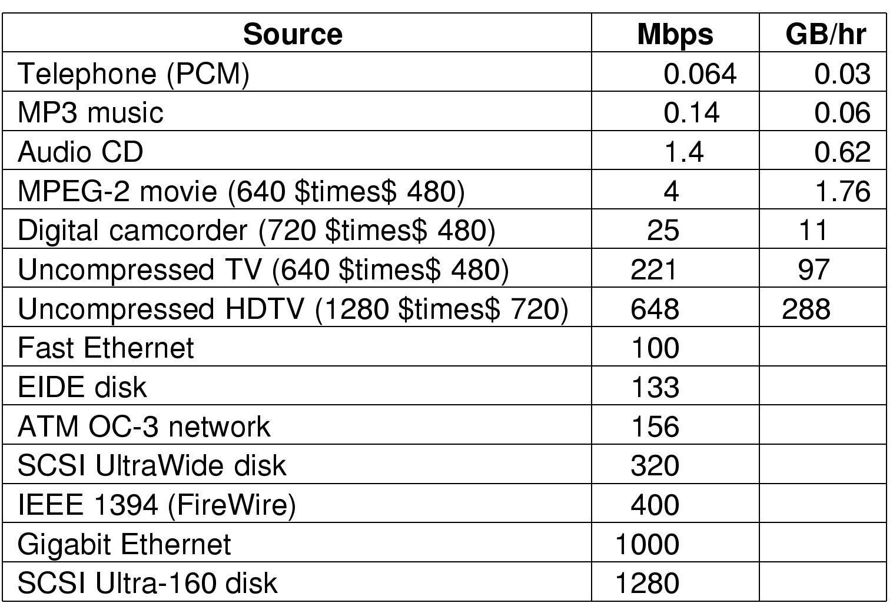
Some data rates: multimedia, high performance I/O devices
Note: 1 Mbps = 10⁶ bits/sec but 1 GB = 2³⁰ bytes

Slide 9
Multimedia
Uses extremely high data rates
  Data has to be compressed for transmission and decompressed at the receiving end
Requires real-time playback
  NTSC (National Television Standards Committee - North and South America and Japan) runs at 30 frames/sec
  PAL (Phase Alternating Line – Germany, Turkey etc., - technically the best) runs at 25 frames/sec
  SECAM (SEquential Colour Avec Memoire – France and Eastern Europe) runs also at 25 frames/sec

Slide 10
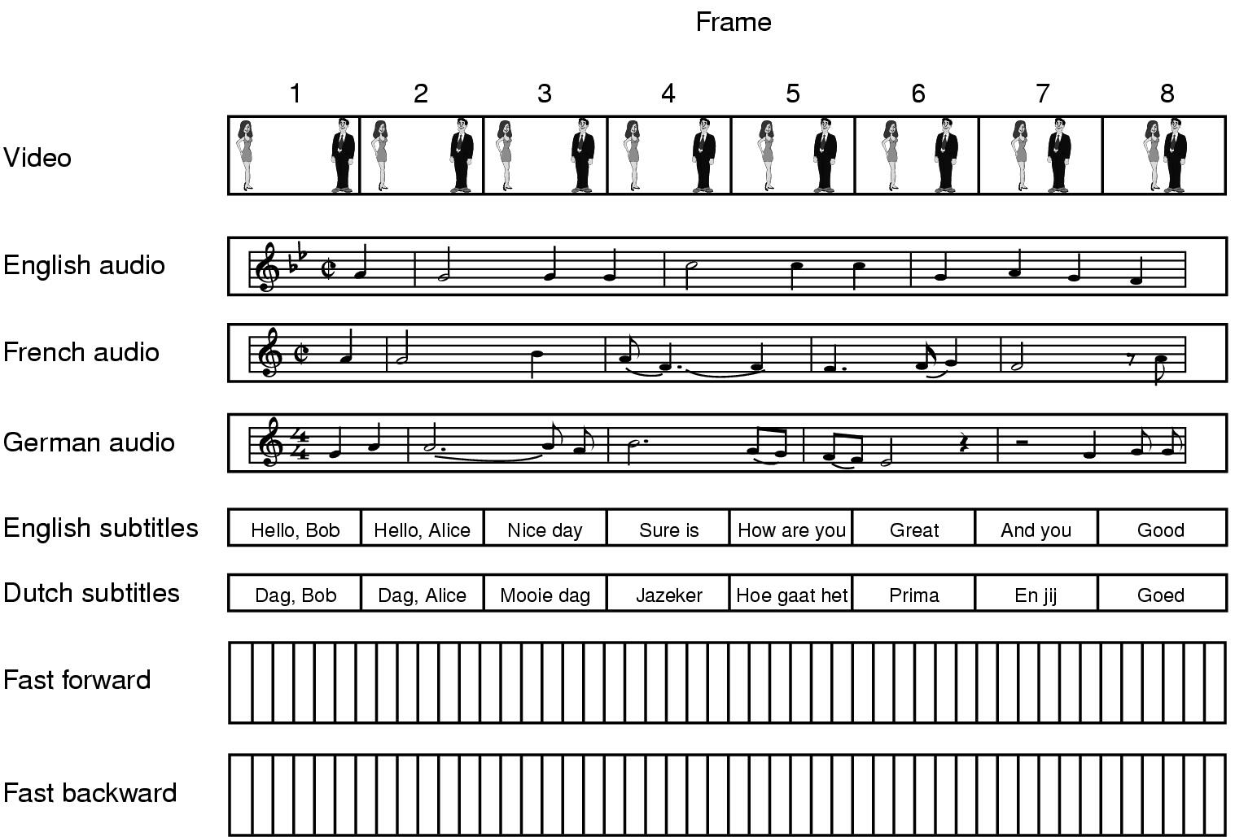
Multimedia Files
A movie may consist of several files which should be synchronized during playback

Slide 11
Audio Encoding (1)
Humans can hear frequencies from 20 Hz to 20,000 Hz
Sound amplitude is measured in decibels (dB)
Ordinary conversion is about 50 dB and pain threshold is about 120 dB

Slide 12
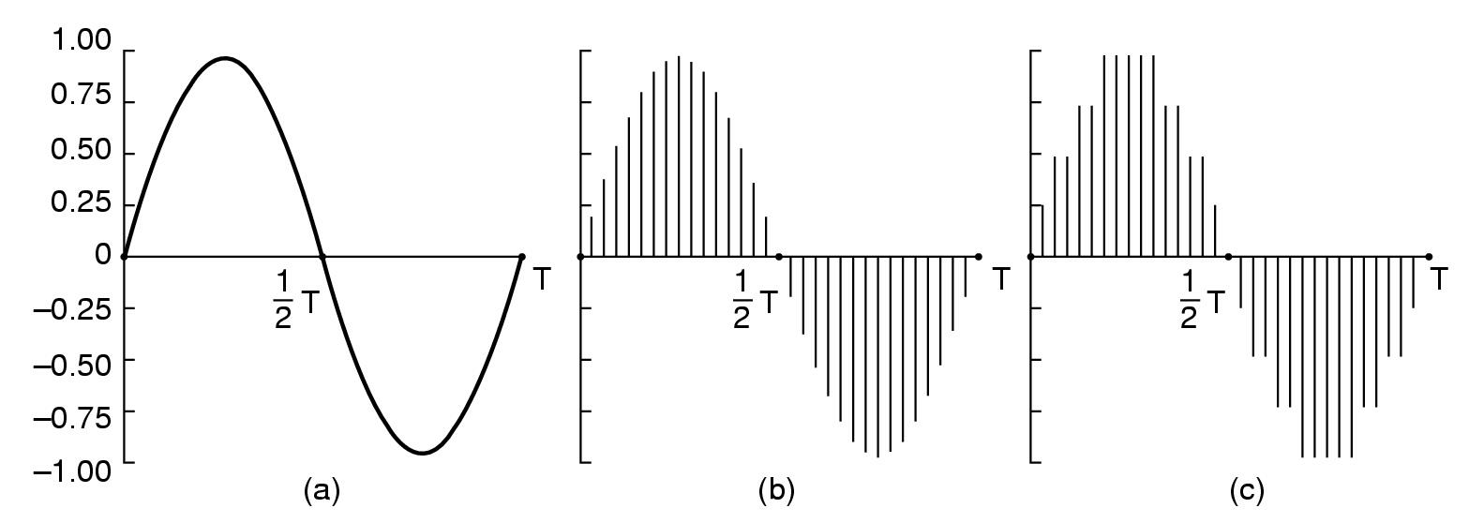
Audio Encoding (2)
A sine wave
Sampled sine wave (amplititues are taken at Δt intervals)
Sample quantized to four bits

Slide 13
Audio Encoding (3)
Conversion from analog audio to digital is done by an analog to digital converter (ADC)
According to the sampling theory: sampling should be done at a frequency of 2f where f is the highest frequency in the audio signal to decode the signal at the receiving end
Error induced by finite sampling is called quantization noise (due to the number of bits chosen to represent an amplitute)
Examples of sampled sound
  telephone – pulse code modulation (8,000 samples/sec - 7-8 bits/sample)
  audio compact disks (44,100 samples/sec – 16 bits/sample)

Slide 14
Video Encoding (1) - Analog
The camera scans an electron beam rapidly across the image and slowly down it, recording the light intensity as it goes
The intensity as a function of time is broadcast, and receivers repeat the scanning process to reconstruct the image

Slide 15
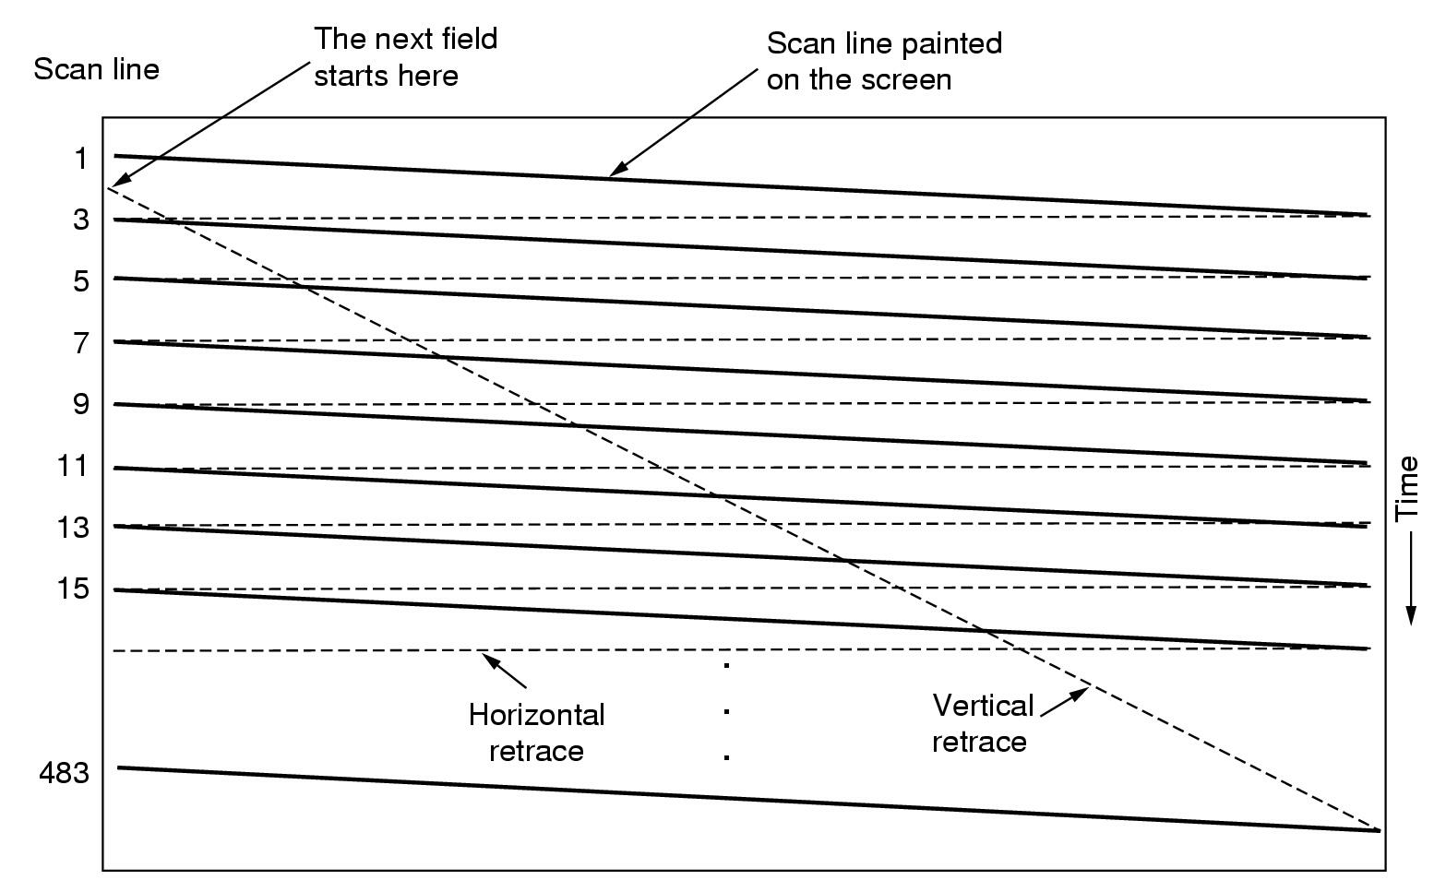
Video Encoding (2) - Analog
Scanning Pattern for NTSC Video and Television

Slide 16
Video Encoding (3) - Analog
NSTC
  525 scan lines (only 483 displayed)
  Horizontal to vertical aspect ratio of 4:3
  30 frames/sec
PAL & SECAM
  625 scan lines (only 576 displayed)
  Horizontal to vertical aspect ratio of 4:3
  25 frames/sec

Slide 17
Video Encoding (4) - Analog
Color video uses the same scanning pattern
Three beams are used: one for each primary color red, green and blue (RGB). Any color is a combination of red, green and blue
To transmit on a single channel, the three color signals are combined into a single composite signal
This composite signal has three components: luminance (brightness), 2 chrominance (color: hue/tint, saturation/color) signals. This arrangement is for allowing color transmissions to be viewed on black-and-white receivers

Slide 18
Video Encoding (5) - Digital
Each frame is represented by a rectangular grid of pixels
Color video uses 8 bits/pixel for each of the RGB colors
To produce smooth motion digital video also displays 25 frames/sec

Slide 19
Video Compression (1)
Manipulating multimedia material in uncompressed form is out of question
Compression and decompression are known as encoding and decoding

Slide 20
Video Compression (2)
Asymmetries
  Encoding once (before transmission. This may be slow), decoding many (when viewed by customers in real time. This must be fast)
  When the decoded output is not exactly equal, the system is said to be lossy. All compression systems used for multimedia are lossy because they give much better compression

Slide 21
Video Compression (3)
Compression Standards
  JPEG (Joint Photographic Experts Group) for still pictures (e.g., photographs)
    often produces 20:1 compression
  MPEG (Motion Picture Experts Group) for videos
    MPEG-1 – video recorder-quality output (352x240 for NTSC) using a bit rate of 1.2 Mbps
    MPEG-2 – broadcast quality video of 4-6 Mbps for a NTSC or PAL broadcast
  MPEG is in a way JPEG encoding on each frame separately

Slide 22
Operating Systems with Multimedia Support
Multimedia needs real-time processing
Operating systems with multimedia support differ from the traditional operating systems in three main ways:
  Process scheduling
  File system
  Disk scheduling

Slide 23
Scheduling Homogeneous Processes (1)
Consider a simple video server to support the display of a fixed number of movies, all using the same frame rate, video resolution, data rate, and other parameters
For each movie a single process (or thread) reads the movie from the disk one frame at a time and then transmit that frame to the user

Slide 24
Scheduling Homogeneous Processes (2)
Since all processes are equally important, do the same activity for each movie, round-robin scheduling is fine
What is needed is a timing mechanism to make sure each process runs at the correct frequency (30 frames/sec for NTSC and 25 frames/sec for PAL and SECAM)
A master clock ticks at the required frequency (say 25 times per second in the case of PAL). At each tick, all processes run one after the other and in the same order.
Process finishing work (frame transmitted) suspends itself and waits for the next tick
As long as the number of processes is small enough that all the work can be done in one frame time, round-robin is sufficient

Slide 25
General Real-Time Scheduling (1)
Number of users changes as viewers come and go, frame sizes vary due to compression, and different movies may have different resolutions
This means several processes have to run at different frequencies, with different amount of work, and with different deadlines

Slide 26
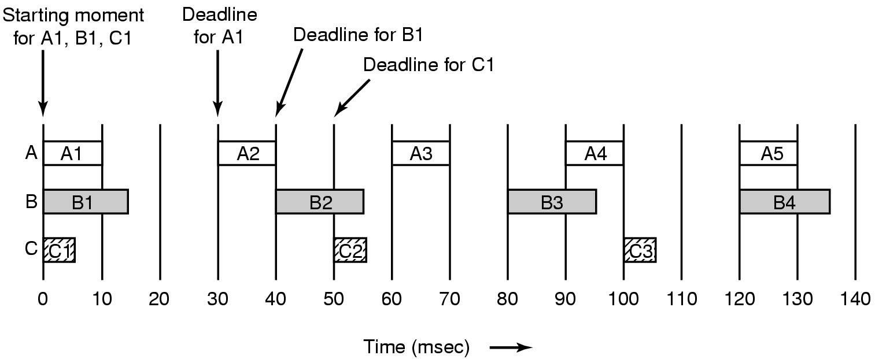
General Real-Time Scheduling (2)
Process | Frames/sec | Deadline (msec) | CPU time/frame (msec)
A | 33 | 30 | 10
B | 25 | 40 | 15
C | 20 | 50 | 5

Slide 27
General Real-Time Scheduling (3)
If process i has a period P_{i} msec and requires C_{i} msec of CPU time per frame, the system is schedulable if and only if
m
C_{i}
Σ
≤ 1
P_{i}
i = 1
where m is the number of processes (0.808 for the previous example)
Real-time algorithms can be either static or dynamic
  RMS (Rate Monotonic Scheduling)
  EDF (Earliest Deadline First Scheduling)

Slide 28
RMS (Rate Monotonic Scheduling)
This is a static real-time scheduling algorithm
Each process has a fixed priority based on its frames/sec value (hence, rate monotonic)
Rule: Each periodic process must complete within its period
Select always the highest priority process
If a high priority process becomes ready for execution at any time, it preempts the running process if there is

Slide 29
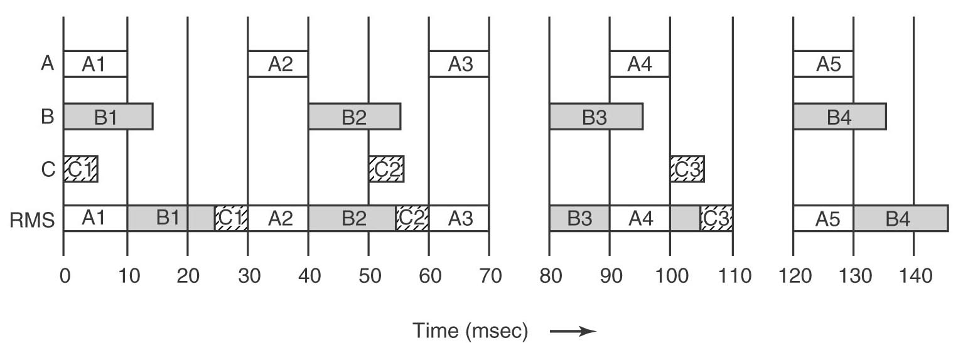
An Example of RMS Scheduling
Process | Frames/sec | Period (msec) | Priority | CPU time/frame (msec)
A | 33 | 30 | 33 | 10
B | 25 | 40 | 25 | 15
C | 20 | 50 | 20 | 5

Slide 30
EDF (Earliest Deadline First Scheduling)
EDF is dynamic algorithm that does not require
  processes to be periodic (RMS does)
  processes to have the same run time per CPU burst (RMS does)
The scheduler keeps a list of runnable processes, sorted on deadline
The algorithm runs the first process on the list, the one with the closest deadline
Whenever a new process becomes ready, the system checks to see if its deadline occurs before that of the currently running process. If so, the running process is preempted

Slide 31
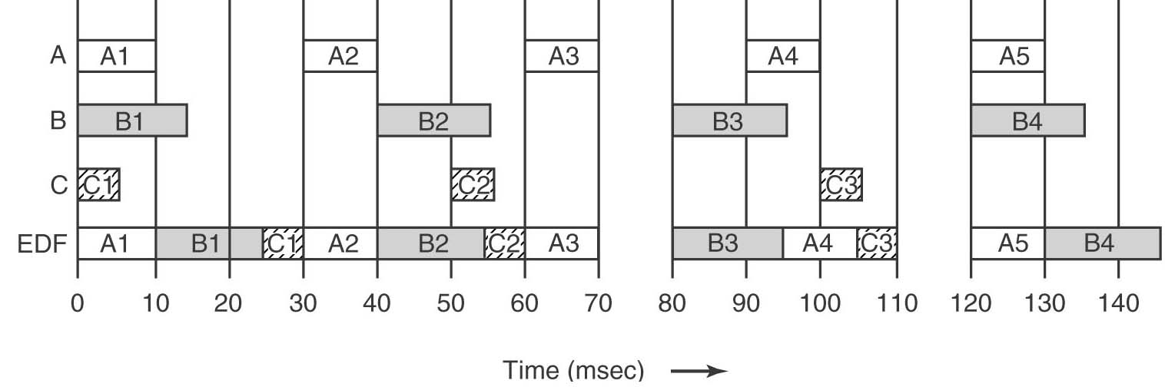
An Example of EDF Scheduling
Deadline times:
A : 0 - 30 - 60 - 90 - 120 - 150
B : 0 - 40 - 80 - 120 – 160
C : 0 – 50 – 100 - 150

Slide 32
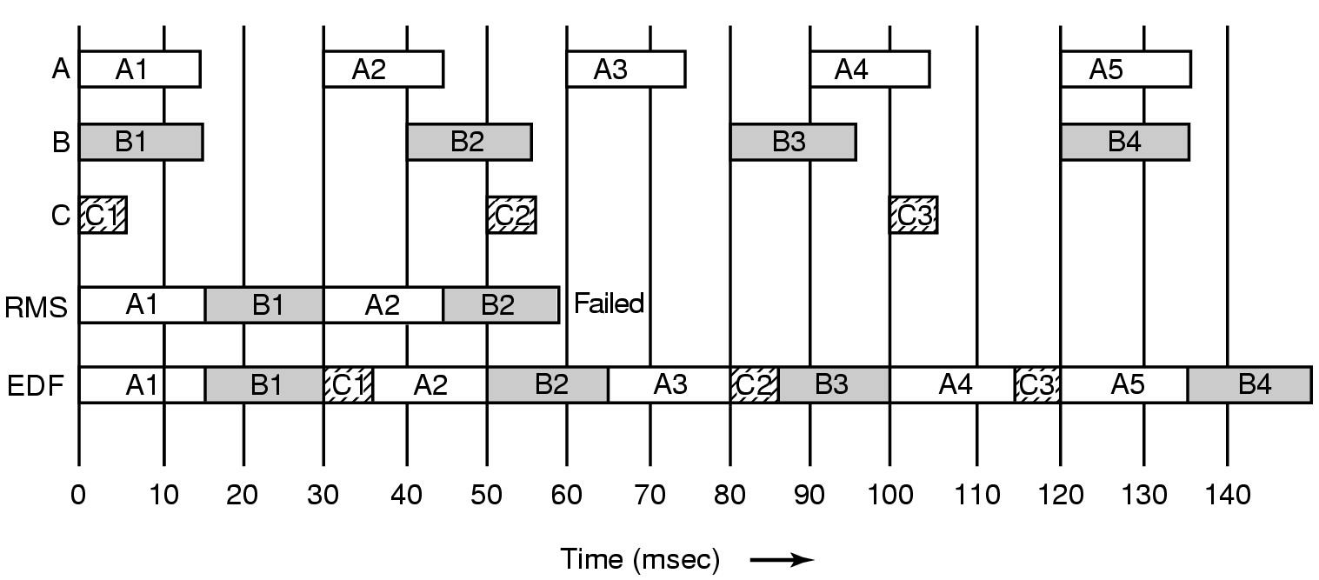
Another example of RMS and EDF
Process A needs 15 msecs instead of 10 msec. RMS fails but EDF works fine.
If the CPU utilization is below an RMS limit (see p.474 of the book) RMS can be used else EDF should be chosen

Slide 33

RMS Limit
RMS is quarantied to work if the above equation holds

Slide 34
Multimedia File Systems (1)
Traditional file systems perform an open, several reads and close at the end
During read operations, processes wait until I/O is finished but timing is not all that important. The data eventually comes.
That is, the user pulls the data in one block at a time by repeately calling read calls to get one block after the other
File servers of this type are often called pull servers (user pulls the data)

Slide 35
Multimedia File Systems (2)
For multimedia,
  read calls must be at fairly specified times
  and
  the video server must be able to supply data blocks without a delay
Multimedia file servers, after a start call, begin sending out frames at the required rate. It is up to the user to handle them at the rate they come in
File servers of this nature are called push servers because they push data at the user

Slide 36
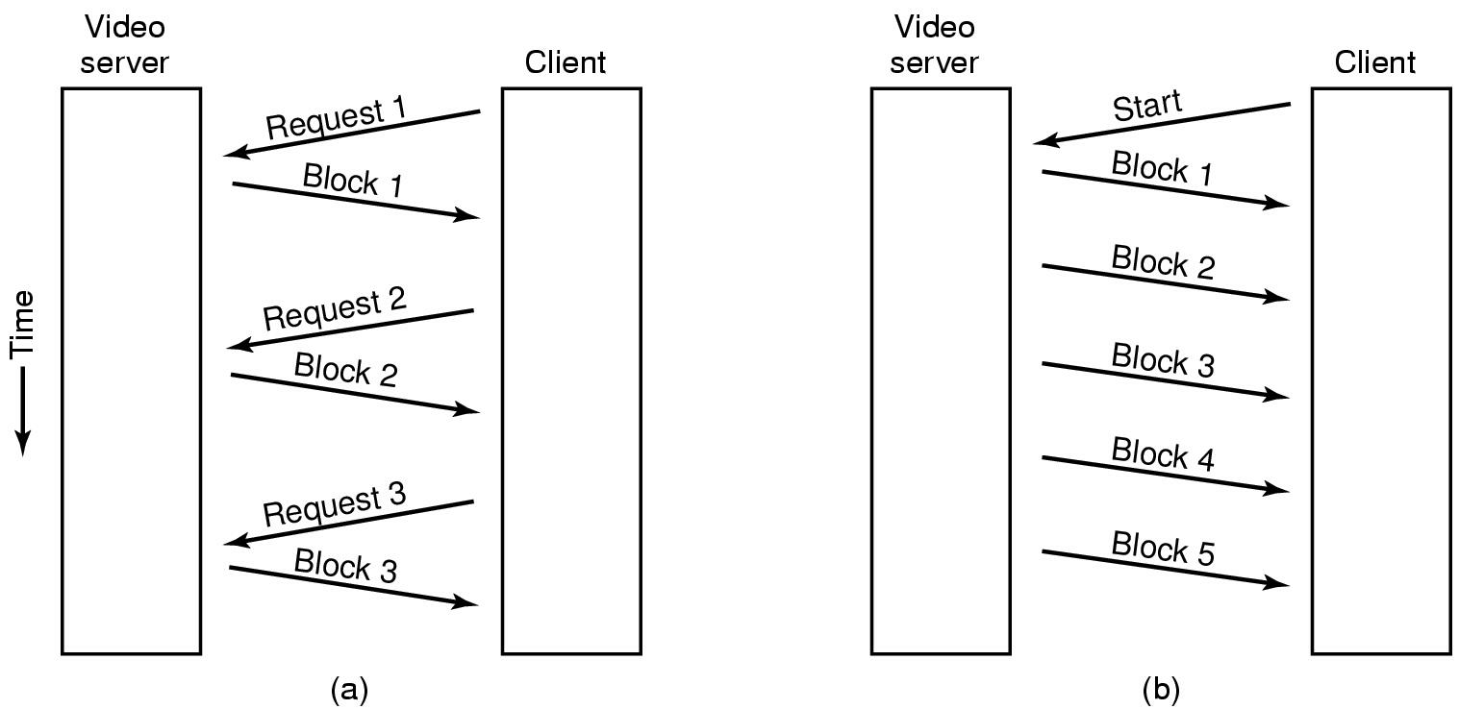
Multimedia File System Paradigms (3)
Pull and Push Servers

Slide 37
VCR Control Functions
Pause is simple
  send a message to the video server to stop
Rewind is simple
  set next frame to zero
Fast forward/backward are trickier
  compression makes rapid motion complicated
  special compressed file containinig say every 10th frame (see slide 7-9)

Slide 38
Near Video on Demand (1)
Having k users getting the same movie puts essentially the same load on the server as having them getting k different movies
Since viewers want to view at arbitrary times one movie stream can not be shared
Tell users that movies start on the hour and every (for example) 5 minutes thereafter. Thus if a user wants to see a movie at 8:02, he will have to wait until 8:05
A 2-hour movie starting at every 5 minutes need 24 (120/5) streams regardless the number of customers.
Viewers starting at the same starting time share the stream

Slide 39
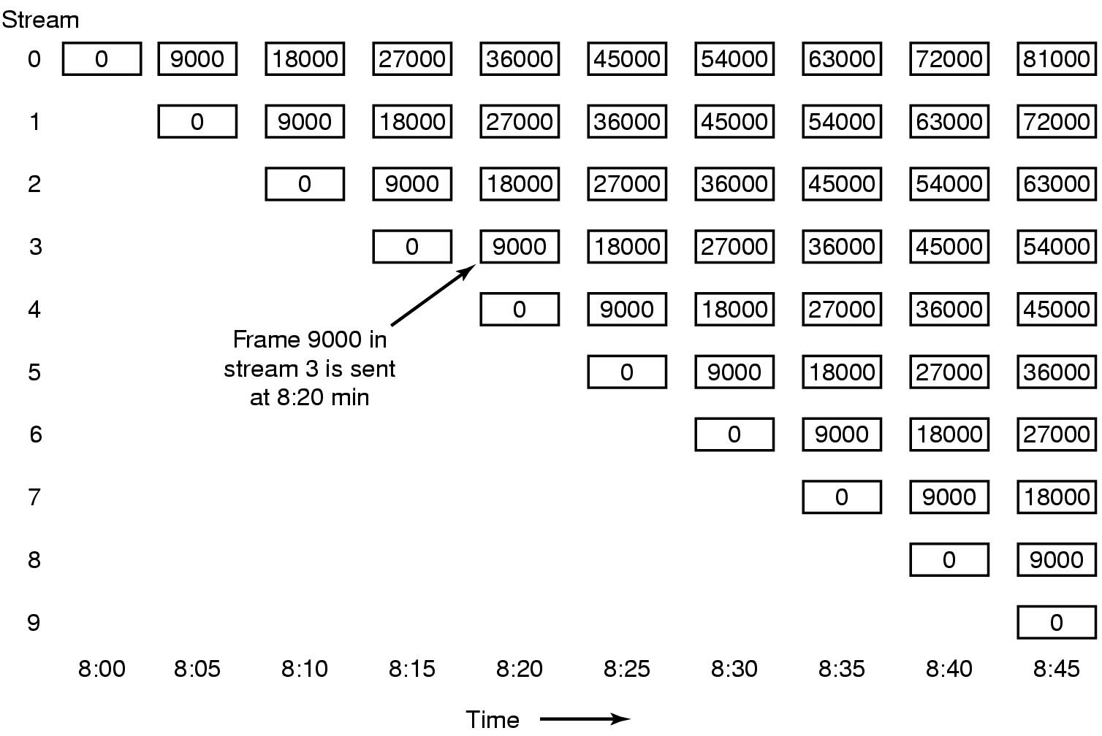
Near Video on Demand (2)
New stream starting at regular intervals (in every 5 minutes for a 2-hour movie)

Slide 40
File Placement
Multimedia files
  Are very large
  Written once but read many times
  Accessed sequentialy

Slide 41
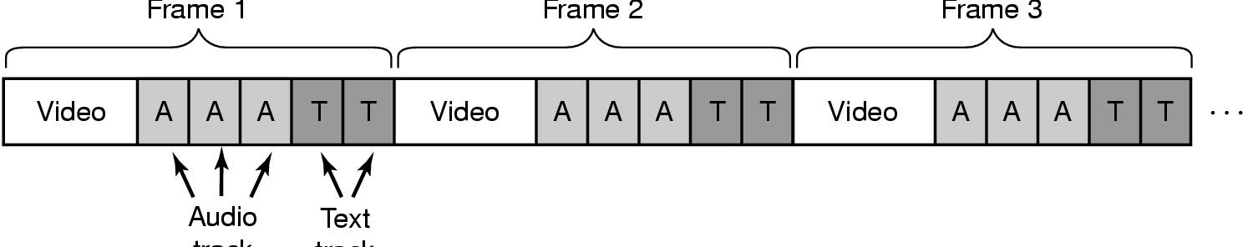
Contiguous Movie Storage
Video, audio, text in single contiguous file per movie instead of separate files for each component
Read one frame in one disk operation and transmit only relevant parts to the user
This organization is not efficient when random access is needed (say for a movie editing system) or in video servers with multiple concurrent output streams (accessing the desired frame from a movie is not easy in a contiguous file)

Slide 42
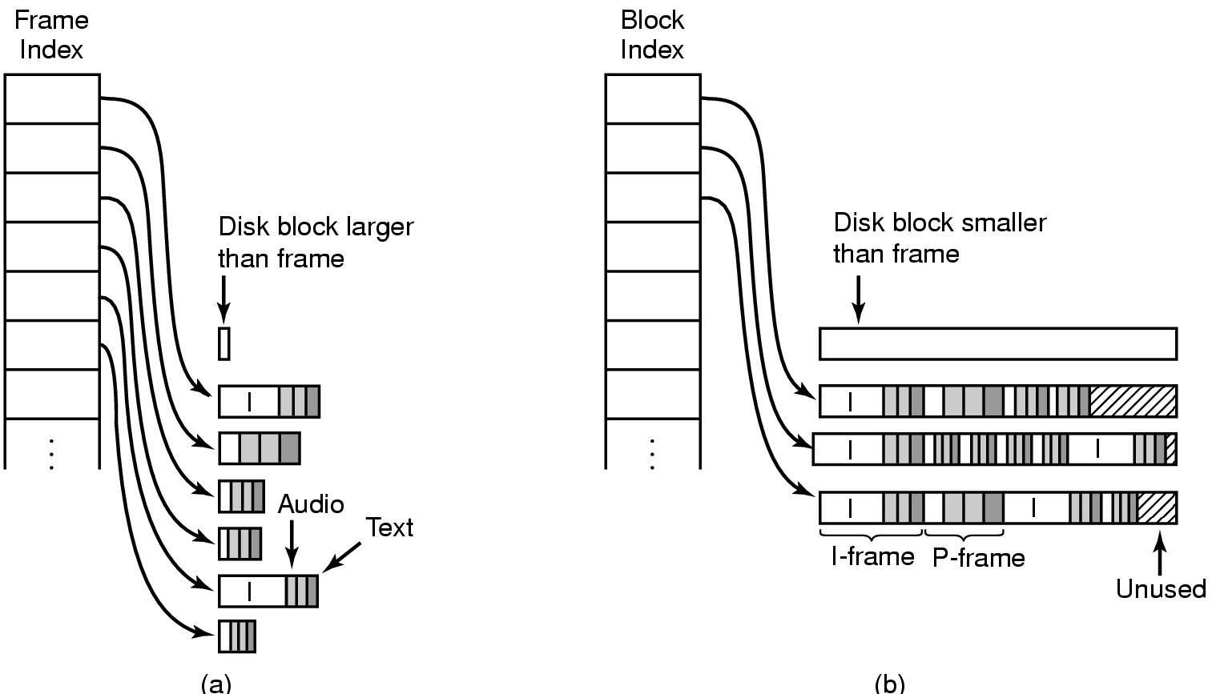
Noncontiguous Movie Storage
Small disk blocks -
  a frame index for the whole movie
  each index points to one frame data (variable frame size)
Large disk blocks
  multiple frames in one block (constant block size)
  a block index for the whole movie

Slide 43
Trade-offs between small, large blocks
Frame index
  heavier RAM usage during movie play (due to variable frame sizes )
  little disk wastage
Block index (no splitting frames over blocks)
  low RAM usage
  major disk wastage
Block index (splitting frames over blocks allowed)
  low RAM usage
  no disk wastage
  extra seeks

Slide 44
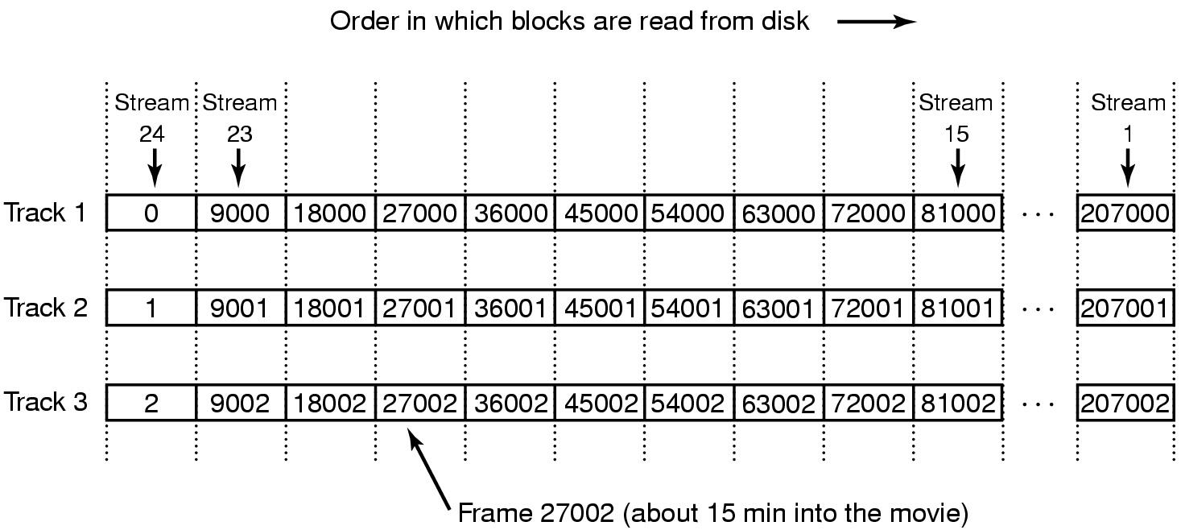
Placing Files for Near Video on Demand
30 frames/sec with a new stream starting every 5minutes
Stream 24 is just starting (stream repeating on the hour every 2 hours)
Frames needed for all 24 streams at that time are in track 1 as a single record which can be read in one read operation
Double buffering is used (playback from one buffer while reading the next 24 frames from the next track)

Slide 45
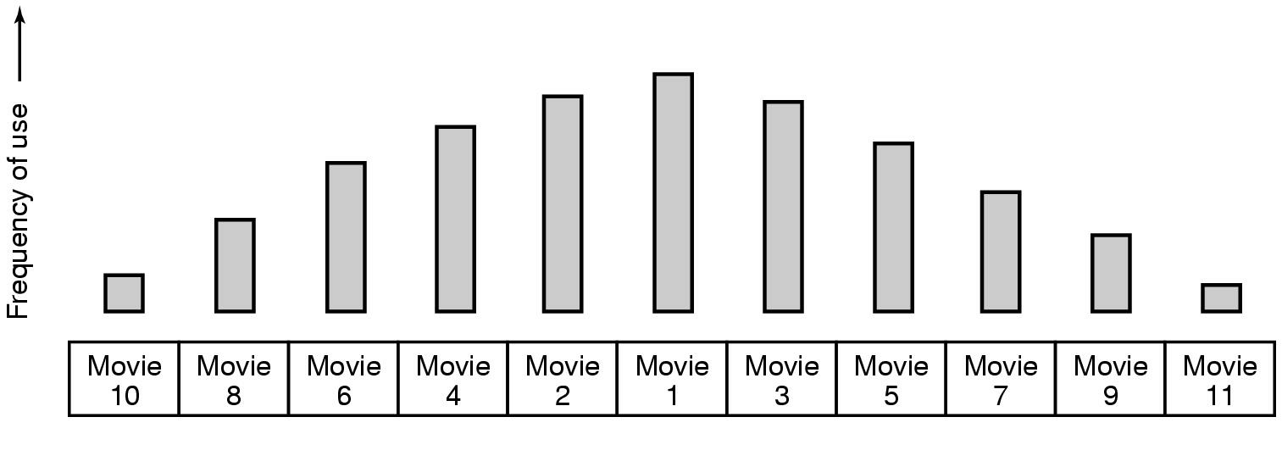
Placing Multiple files on a Single Disk
Organ-pipe distribution of files on server
  most popular movie in middle of disk
  next most popular either on either side, etc.
This strategy is based on statistical analysis of popularity (see Zipf’s law)
For a 1000 movie server, top 5 movies represent a total probability of .307, which means that the disk arm will stay in the cylinders allocated to the top five movies about 30% of the time

Slide 46
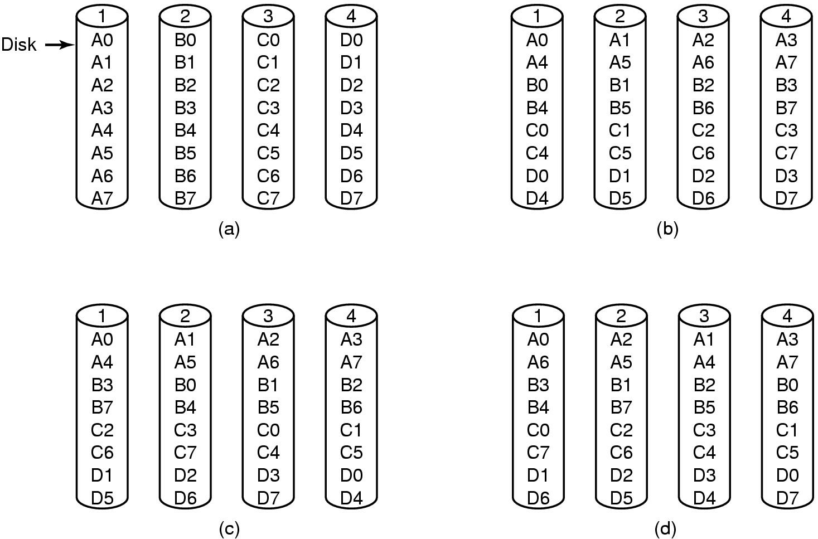
Placing Files on Multiple Disks
Organize multimedia files on multiple disks to balance the load on disks
  (a) No striping – one disk holds all frames of a movie - popular films may cause a strain on the relevant hard disk
  (b) Same striping pattern for all files – all movies start from the same disk
  (c) Staggered striping
  (d) Random striping
This organization is not a RAID (no error correction is required – but high performance definitely)

Slide 47
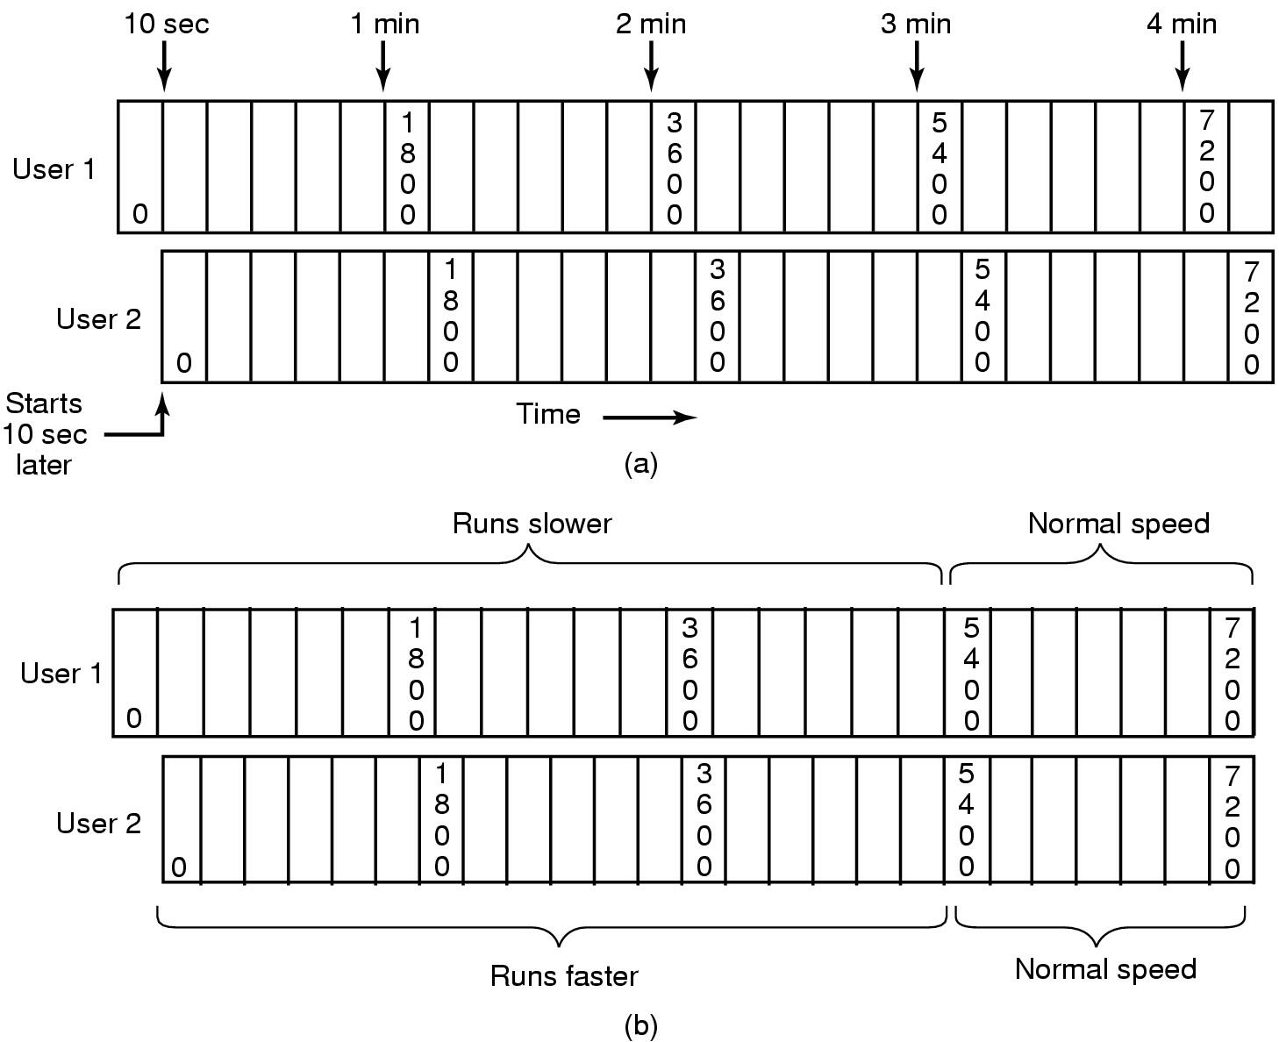
Caching
Block Caching
Two users, same movie 10 sec out of sync – keep the blocks in cache, but this wastes memory
Merging two streams into one by running the first movie a bit slower and the other a bit faster for a while

Slide 48
File Caching
Most movies are stored on DVD or tape to save disk space
  copy to disk when needed
  results in large startup time
  keep most popular movies on disk
Can keep first few minutes of all movies on disk
  start movie from this while remainder is fetched

Slide 49
Disk Scheduling for Multimedia
Traditional OS
  requests for disk blocks is unpredictable
  rerform one-block read ahead for each file to increase performance
  other than that, wait for requests to come in and process them on demand
Multimedia OS
  each active stream puts a well defined load on the system that is highly predictable (for PAL, a frame is needed every 40 msec)

Slide 50
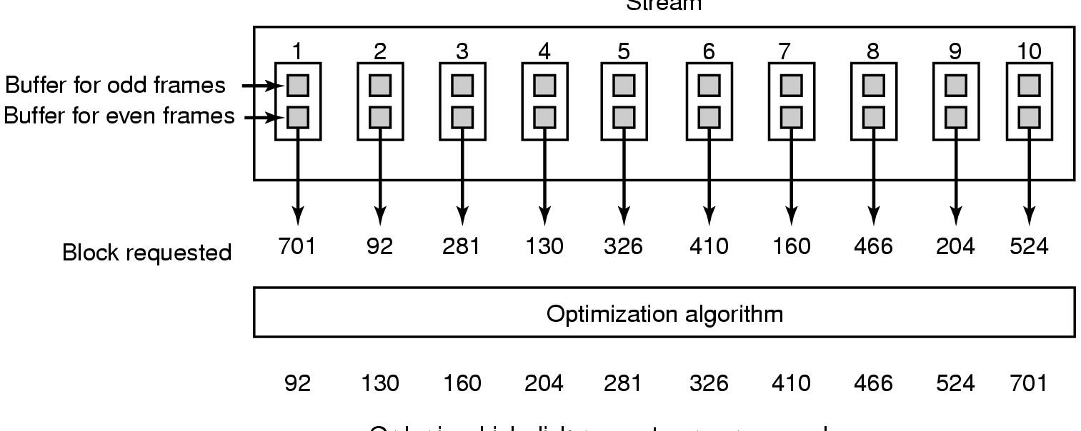
Static Disk Scheduling for Multimedia
Time is divided into rounds, where a round time is the frame time (40 msec for PAL)
In one round, each movie asks for one frame (no requests till the the next round)
Sort the requests in the optimal way – probably in cylinder order
Use double buffering in the server
Works well if all streams have the same properties (frame rate, resolution etc.)

Slide 51
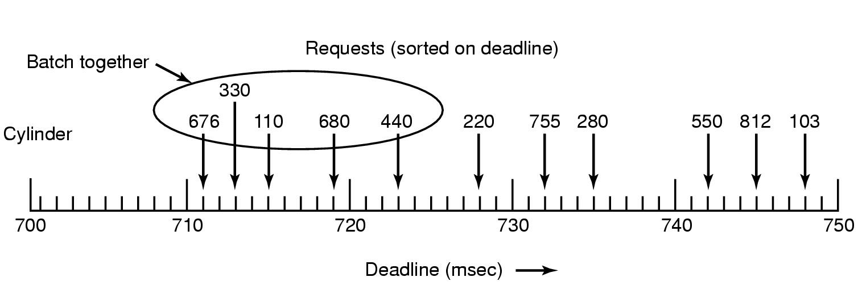
Dynamic Disk Scheduling – Scan EDF
Dynamic scheduling is needed for movies with different properties
Scan-EDF algorithm uses deadlines & cylinder numbers for scheduling
Collect requests whose deadlines are relatively close together into batches and process these in cylinder order using the elevator algorithm

